Slide 1
Using Bayesian Optimization in Pose Graphs Based SLAM 4th August
Zuxun Wang

Slide 2
Progress Since Last Meeting
Fix Q33, and run BayesOpt to learn R11, R22, Q11, Q22.
Implement BayesOpt for Linear system.
Evaluate other GP hyperparameters.
Test with different acquisition functions
Test with a larger number of function evaluations
Attempt to implement the Student's t-distribution.

Slide 3
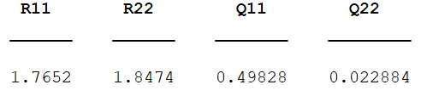
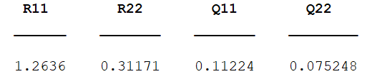
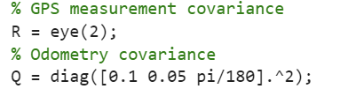
GPS BayesOpt Fixing Q33 Results (Disable Proposition 4)
Total number of timestep: 20
Number of episodes: 2000
AcqFunc: ExpectedImprovementPlus
Total number of timestep: 40
Number of episodes: 10000
AcqFunc: ExpectedImprovementPlus
Min Objective: 0.0016
Min Objective: 0.0056

Slide 4
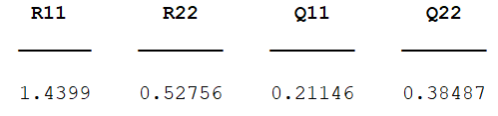
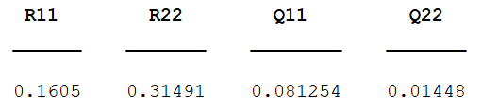
GPS BayesOpt Fixing Q33 Results (Enable Proposition 4)
Total number of timestep: 20
Number of episodes: 2000
AcqFunc: ExpectedImprovementPlus
Total number of timestep: 40
Number of episodes: 10000
AcqFunc: ExpectedImprovementPlus
Min Objective: 5.209807906350498e-04
Min Objective: 7.265123661746896e-04

Slide 5
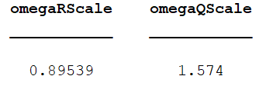
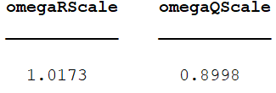
Linear BayesOpt With Different Evaluation Numbers(Enable Proposition 4)
Total number of timestep: 100
Number of episodes: 1000
Evaluation Time: 30
AcqFunc: expected-improvement-plus
Total number of timestep: 100
Number of episodes: 1000
Evaluation Time: 100
AcqFunc: expected-improvement-plus
Min Objective: 0.035836137725751
Min Objective: 0.017948518732610

Slide 6
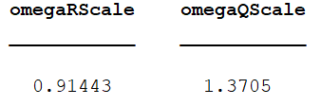
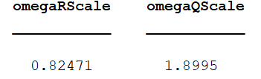
Linear BayesOpt With Different Acquisition Functions(Enable Proposition 4)
Total number of timestep: 100
Number of episodes: 1000
Evaluation Time: 100
AcqFunc: expected-improvement-plus
Total number of timestep: 100
Number of episodes: 1000
Evaluation Time: 100
AcqFunc: expected-improvement-per-second-plus
Min Objective: 0.010350265956489
Min Objective: 0.011431619068736

Slide 7
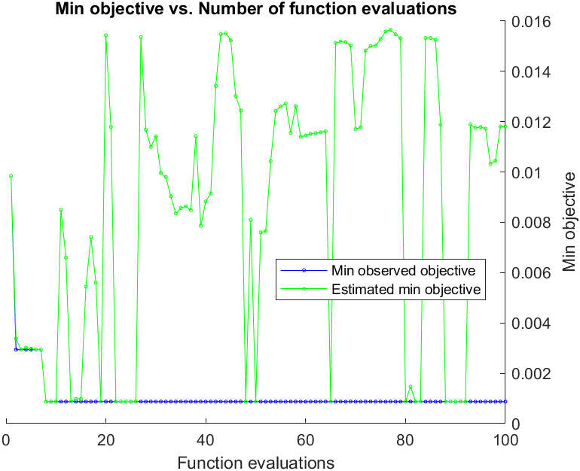
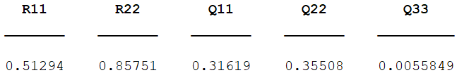
GPS BayesOpt Results (Enable Proposition 4)
Total number of timestep: 40
Number of episodes: 10000
Evaluation Time: 100
AcqFunc: expected-improvement-per-second-plus
Min Objective: 8.731664127759034e-04

Slide 8
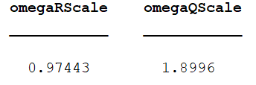
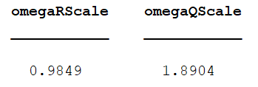
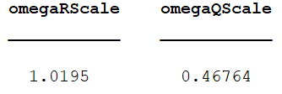
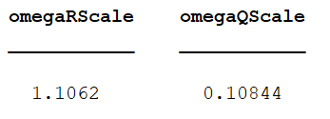
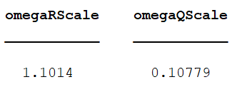
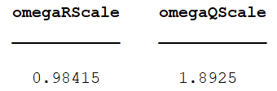
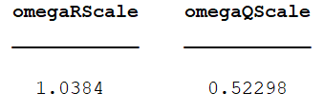
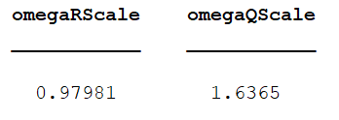
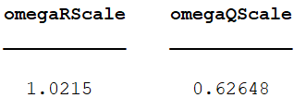
GPS BayesOpt Results (40-10000_Prop4)

Slide 9
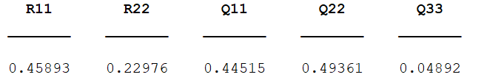
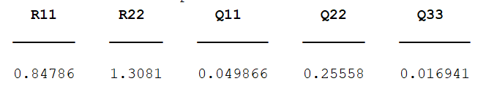
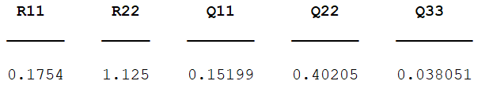
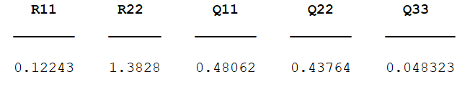
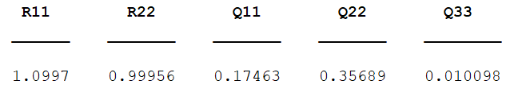
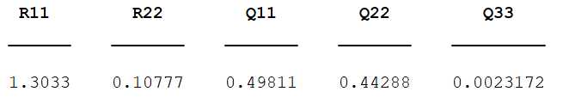
GPS BayesOpt Results (40-10000_Prop4)

Slide 10
Problems / Issues
Use MATLAB built-in bayesopt function to implement student-t process as a surrogate model can be extremely complex and tough.
1. The `fitrgp` function does not directly support fitting a Student-t process to my data. The fitting process will likely involve maximum likelihood estimation or a similar method.
2. Once a fitted Student-t process is constructed, we’ll also need to make predictions for the unobserved values by ourselves, as the predict function in MATLAB only works with GPs.
3. Then we can use the student-t process as the surrogate model, and we also have to write acquisition function by ourselves.
4. Finally, we can use the customised bayesopt function.

Slide 11
Planned Activities
Try to fix Q. estimate R
Other way around
Estimate covariances
function [x, Px] = computeMarginals(this, vertices)
Check the ground truth values.
Compare two CNIS values.

